Slide 1
PSALM 119
IN THE WORD

Slide 2
Context
The longest chapter in the Bible
176 verses
22 stanzas, 8 verses in each
An acrostic poem (each stanza/section titled with a letter of the Hebrew alphabet)

Slide 3
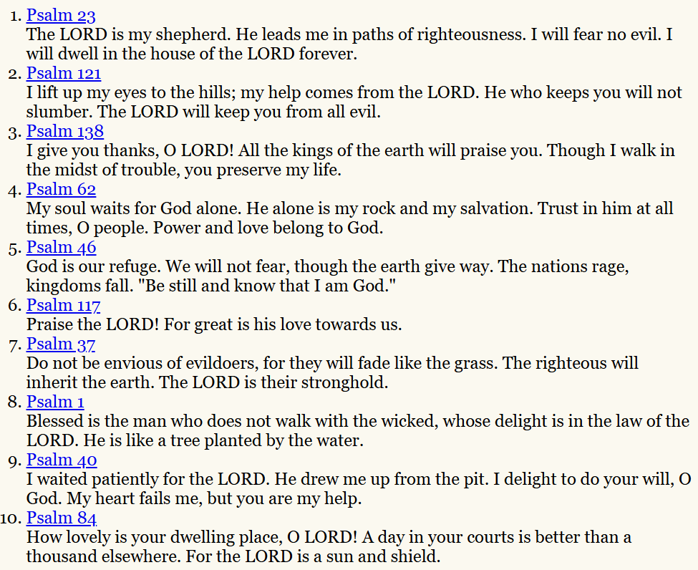
TOP 10 PSALMS (according to biblesummary.info)

Slide 4
PSALM 199
Delight in the Word
Awe and adoration of the Word
A guide for living in the Word

Slide 5
Verses 13-16
“With my lips I have declared all the judgements of Your mouth. I have rejoiced in the way of your Testimonies, as much as in all riches. I will meditate on Your precepts, and contemplate Your ways. I will delight myself in Your statutes; I will not forget Your word.”

Slide 6


Slide 7
VERSE 97
“Oh, how I love your Law! It is my meditation all the day!”
“A love of God not desiccated by study but refreshed, informed and nourished”

Slide 8
VERSE 73
“Your hands have made me and fashioned me; give me understanding, that I may learn your commandments.”

Slide 9
VERSE 161-162
“Princes persecute me without a cause, but my heart stands in awe of your word. I rejoice at your word as one who finds great treasure.”

Slide 10
VERSE 157
“Many are my persecutors and my enemies, yet I do not turn from Your testimonies.”

Slide 11
VERSES 36-37
“Incline my heart to your testimonies, and not to covetousness. Turn away my eyes from looking at worthless things, and revive me in your ways!”

Slide 12
VERSES 10-11
“With my whole heart I have sought you; oh, let me not wander from your commandments! Your word I have hidden in my heart, that I might not sin against you!”

Slide 13
V101-102 says “I have restrained my feet from every evil way, that I may keep your Word. I have not departed from your judgements, for you yourself have taught me.”
V29-30 “Remove from me the way of lying and grant me your law graciously. I have chosen the way of truth; your judgements I have laid before me.”
V105 “Your Word is a lamp to my feet and a light to my path”

Slide 14
VERSES 33-34
“Teach me, oh Lord, the way of your statutes, and I shall keep it to the end. Give me understanding, and I shall keep your Law; indeed I shall observe it with my whole heart. Make me walk in the way of your commandments, for I delight in it.”

Slide 15
LUKE 9:23
“If anyone would come after me, let him deny himself and take up his cross daily and follow me”

Slide 16
VERSES 111-112
“Your testimonies I have taken as a heritage forever, for they are the rejoicing of my heart. I have inclined my heart to perform your statutes forever, to the end.”

Slide 17

“What is the chief end of man? Man’s chief end is to glorify God, and to enjoy Him forever.”
Delight in the Word
Awe and adoration of the Word
A guide for living in the Word

